Slide 1
Community Focus.
World Impact.
April 25, 2012
Harry Lester, President
Dr. Richard Homan, Dean & Provost
Dr. Terri Babineau, Dir. of Community Outreach
Krishna Aluri, MD 2014
Jon Gellman, MD 2013
Notes:
WELCOME & INTRODUCTION OF PRESENTERS
Lester:
Welcome Brocks.
Discuss importance of this opportunity to EVMS and community.
This is an excellent chance to make a gift that will have profound impact on Hampton Roads and beyond.
Introduce Dean Homan
Homan:
Welcome
Exciting time at EVMS as we continue our efforts to become the most community-oriented school of medicine and health professions in the country.
One of the exciting things about this school and it’s outreach efforts is that MD students and Health Professions students work together. This is the future of medicine.
Service learning is an important part of our curriculum and our goal is to build a culture of service that lasts a lifetime.
Introduce Dr. Terri Babineau, Director of Student Community Outreach
Introduce students: Krishna Aluri, MD Class of 2014 & Jon Gellman, MD Class of 2013
Babineau:
CLICK to advance to next slide

Slide 2
Community Focus.
World Impact.
Created by the community.
Created for the community.
Notes:
[Animation occurs automatically]
As you know, EVMS was created BY the community and FOR the community.
Group of citizens concerned with a lack of high-quality specialty medical care in the region banded together in the late 1960s early 70s to raise the money to found the medical school.
As a result, EVMS has always had a a strong connection and commitment to the community.
CLICK to advance to next slide

Slide 3
Community Focus.
World Impact.
Connecting your gift
to caring students &
a lifetime commitment to community service.
Notes:
Purpose of today’s presentation is to talk about how you can support that community focus and connect your gift to a lifetime commitment to community service.
We’ll share a few brief examples with you today of how our students become embedded in a culture of service and how that benefits Hampton Roads and other areas.
CLICK to advance to next slide

Slide 4
Community Focus.
World Impact.
Connecting your gift
to caring students &
a lifetime commitment to community service.
Notes:
[Animation occurs & slide advances automatically]

Slide 5
HOPES Clinic
Hampton Roads
Beyond Clinic
Walls
Notes:
[Animation occurs automatically]
We’ll begin by talking about our HOPES Clinic… which you’ve had the opportunity to see first-hand.
Krishna Aluri serves as Clinic Coordinator for the HOPES Clinic. He’ll tell you a bit about how both our community and our students benefit from this program.
CLICK to advance to next slide

Slide 6
HOPES Clinic
Hampton Roads
Beyond Clinic
Walls
Notes:
[Animation occurs & slide advances automatically]

Slide 7
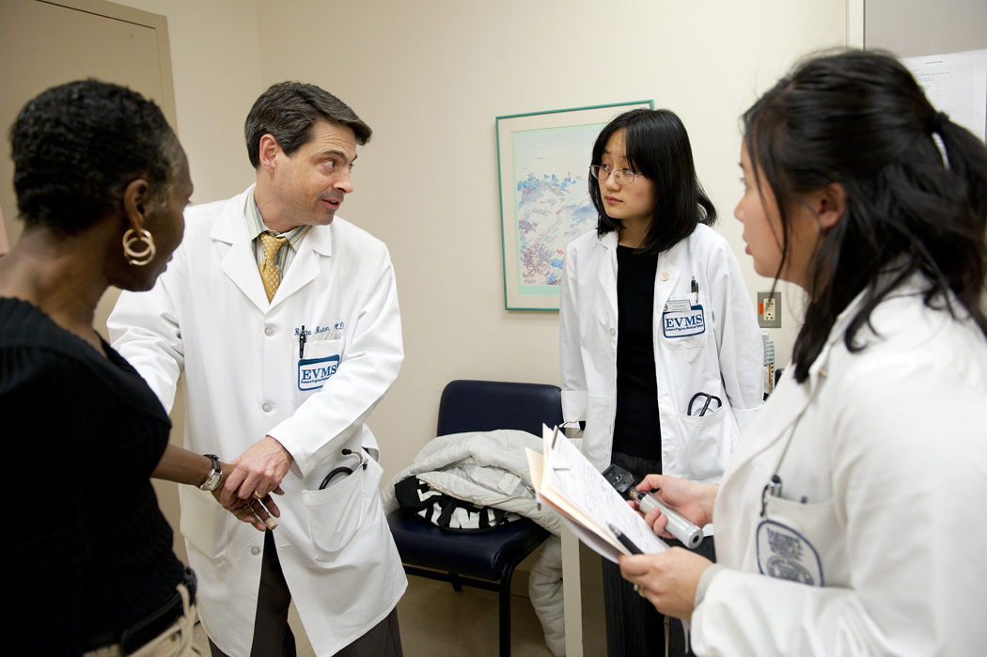
HOPES Clinic
Notes:
Aluri:
Need to craft on brief example here of how educational experiences spur a lifetime commitment to community service.
Discuss briefly:
Types of service performed in Haiti
Impact on students who participated
What kinds of comments did they make about the experience?
How has this increased their passion for service?
Babineau:
We are capitalizing on community resources and building new partnerships to better serve the community. For example, we work with:
ODU (Dental Hygiene)
Hampton University (Pharmacology School)
Lions Club (glasses)
EVMS Sub-Specialty Clinics (Ophthalmology, OB/GYN, Dermatology, Psychiatry)
ACCESS AIDS
CLICK to advance to next slide

Slide 8
HOPES Clinic
Hampton Roads
Beyond Clinic
Walls
Notes:
[Animation occurs & slide advances automatically]
SHORT TIME TO MAKE YOUR STATEMENT DURING ANIMATION/TRANSITION
Another example of how our students contribute to the community is the Beyond Clinic Walls Program. We’ll share a brief video about these efforts.

Slide 9
HOPES Clinic
Hampton Roads
Beyond Clinic
Walls
Notes:
[Animation occurs & slide advances automatically]
Our students also volunteer around the Commonwealth. For example, with the Remote Area Medical program that helps those in rural Virginia who lack access to quality care. [video example]

Slide 10
The Commonwealth
Remote Area
Medical
Notes:
[Animation occurs & slide advances automatically]

Slide 11
The Commonwealth
Remote Area
Medical
Notes:
[Animation occurs & slide advances automatically]

Slide 12
The World
HOPES Haiti (Telemedicine)
Notes:
Our students’ educational experiences and service efforts also have a global impact… For example, our efforts in Haiti.
We’ll see a brief video clip and then Jon Gellman will talk to you about his experiences in Haiti and how he and his fellow students have been impacted by this opportunity.
CLICK to advance to next slide

Slide 13
The World
HOPES Haiti (Telemedicine)
Notes:
[Animation occurs & slide advances automatically]

Slide 14
The World
HOPES Haiti
(Telemedicine)
Notes:
[Animation occurs & slide advances automatically]

Slide 15
Creating Engaged
Medical & Health
Professionals
Notes:
Our ultimate goal is to create engaged medical and health professionals… to train the next generation of caregivers in a culture of service.
This aligns with our vision to become the most community-oriented school of medicine and health professions in the nation.
CLICK to advance to next slide

Slide 16
STRONG CURRICULUM
OPPORTUNITY TO SERVE
CULTURE OF SERVICE
Notes:
[Animation occurs automatically]
We see three major forces shaping our students during their time at EVMS:
A longstanding culture of service
A strong curriculum
Opportunities to serve
This last area is a place where your gift can make a profound impact.
CLICK to advance to next slide

Slide 17
ENTER AS INTERESTED STUDENT
EXIT AS A COMMITTED LEADER
Notes:
[Animation occurs automatically]
Our students come here because they want to be involved. Students like _____________________ [example student from intro]
They will leave as medical leaders with a lifetime commitment to community service.
CLICK to trigger animation
Once they graduate and become doctors or health professionals, they will take a piece of EVMS… and our culture of service… with them wherever they go.
CLICK to advance to next slide

Slide 18
Serving others & impacting the community for a lifetime
Notes:
By instilling this culture of service in our students and residents, we can impact many more lives.
CLICK to trigger animation
Your gift can impact many more lives.
Your gift can effect change in the world, in the Commonwealth of Virginia, and in Hampton Roads.
CLICK to advance to next slide

Slide 19
Hampton Roads
The Commonwealth
The World
Notes:
[Animation occurs & slide advances automatically]
SHORT TIME TO MAKE YOUR STATEMENT DURING ANIMATION/TRANSITION
We wan to share one final video clip with you today… it’s about our student-run Community Care Day.

Slide 20
Community Care Day 2011
Notes:
[Video plays automatically]
After video concludes:
We want to emphasize that last line… the students benefit most form being outside the classroom in our free clinic… or programs like Community Care Day where they can meet those in need… where they can learn from their patients and provide vital services. We want to ensure our students develop a lifetime commitment to community service.
CLICK to advance to next slide

Slide 21
Community Focus.
World Impact.
Connecting your gift
to caring students &
a lifetime commitment to community service.
Notes:
Babineau:
***Conclusion here
REMEMBER: BIG PAUSE
At this time, I’d like to turn the presentation back over to President Lester and Dean Homan.
CLICK to advance to next slide

Slide 22
Community Focus.
World Impact.
Connecting your gift
to caring students &
a lifetime commitment to community service.
Notes:
[Animation occurs & slide advances automatically]

Slide 23
Community Focus.
World Impact.
Questions & Further Discussion
Notes:
Questions & Further Discussion (led by Lester & Homan)
Gift ask (Lester)

